Slide 1
Title: Agentic RAG Chatbot for Multi-Format Document QA using Model Context Protocol (MCP) Objective: Build a chatbot that can answer questions based on uploaded documents (PDF, PPTX, DOCX, etc.) using an agent-based architecture with MCP. Model: Gemini 1.5 Flash Tech Stack: Streamlit (Frontend UI) Python (Backend) FAISS (Vector Store) Gemini API for Embeddings and LLM Responses Model Context Protocol (MCP)
- By Harivadan Kilambi

Slide 2
System Architecture and MCP Flow
Agent-Based Architecture with MCP
Model Context Protocol (MCP)
Each message exchanged between agents follows a structured protocol:
Json
{ "sender": "IngestionAgent", "receiver": "RetrievalAgent", "type": "DOCUMENT_CHUNKS", "data": { ... } }
User ➡️ app.py ➡️ IngestionAgent
⬇
(Parsed Chunks + Embeddings)
⬇
➡️ RetrievalAgent
⬇
(Relevant Context Chunks)
⬇
➡️ LLMResponseAgent
⬇
Gemini Flash
⬇
Final Response ➡️ User

Slide 3
Tech Stack Used
Embeddings & Vector Search:
Gemini Embeddings – via models/embedding-001
FAISS – Local vector store for similarity search
SentenceTransformers – Backup (if used)
File Handling / Parsing:
PDF, PPTX, DOCX, TXT, MD, CSV – via custom parsers
LLM (Q&A):
Gemini 1.5 Flash – fast, low-latency responses
Optional: Gemini Pro (can be swapped)
Frontend / Deployment:
Streamlit – Interactive UI + fast deployment
Streamlit Cloud – Free web deployment
Agents & Architecture:
Python – Core agent logic
Model Context Protocol (MCP) – Agent message coordination
Modular Agents – IngestionAgent, RetrievalAgent, LLMResponseAgent

Slide 4
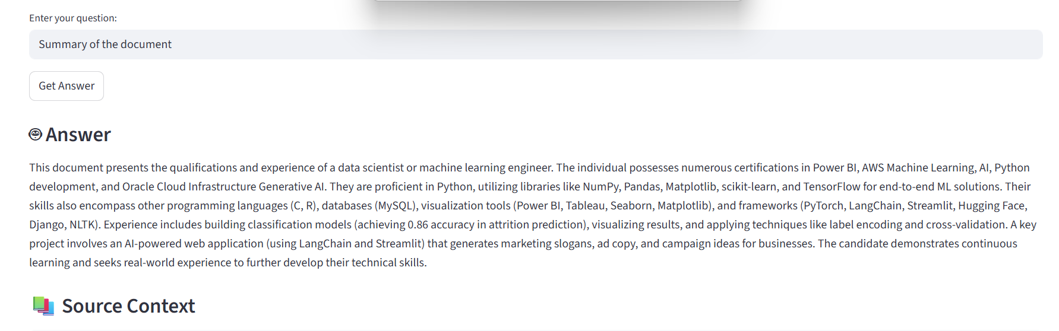
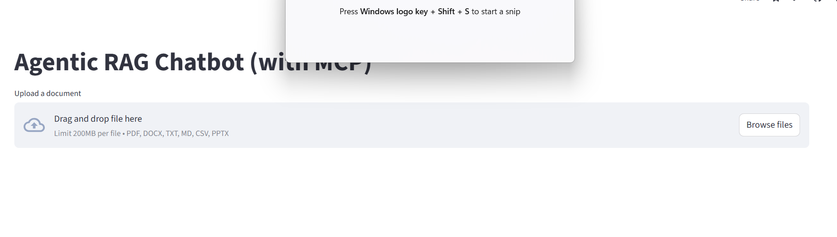
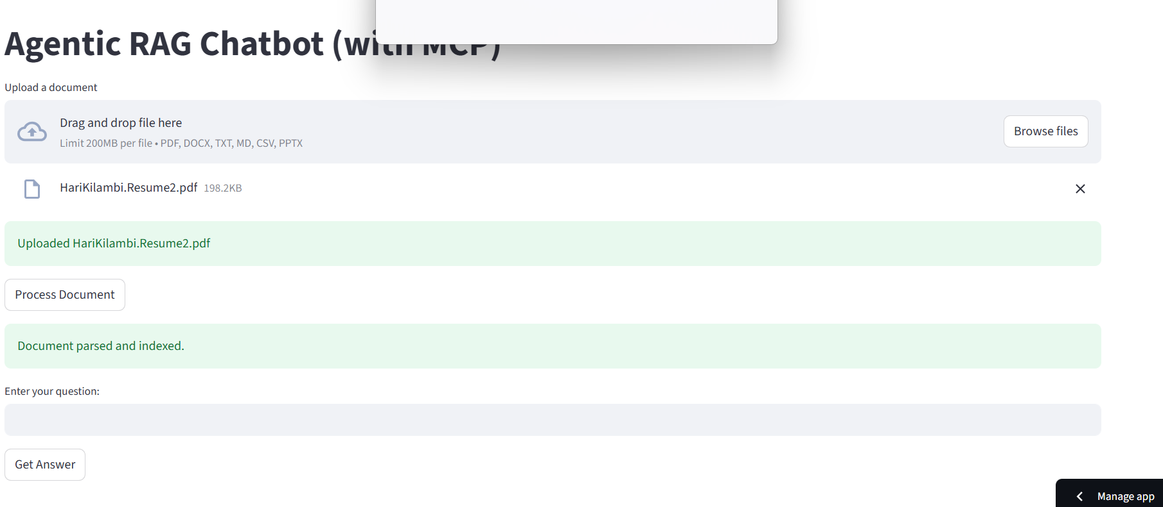
UI Screenshots – Streamlit Web App

Slide 5
Challenges Faced During Development
Gemini API Quotas:
Hit rate limits (429 errors) during testing
Limited free-tier requests per minute → required retries or pacing
Streamlit Cloud Constraints:
No GPU access → forced SentenceTransformer to run on CPU
File size limits and temporary storage issues
Multi-format Document Parsing:
PPTX parsing needed special handling (e.g., slide-level chunking)
Some formats lackedclear text structure, causing uneven chunk sizes
Message Passing Between Agents (MCP):
Designing a consistent message schema
Debugging communication flow between agents
Gemini + FAISS Integration:
Needed to test embeddings quality from Gemini vs. local models
Ensuring vector dimensions matched for FAISS indexing

Slide 6
Thank you!

